Slide 1
Ride Analysis for Namma Yatri

Slide 2
Agenda
Business Background
Business Objectives/ Problem Statement
Analysis approach
Findings from EDA
Conclusions & Recommendations

Slide 3
Business Background & Objectives

Slide 4
Business Background
Namma Yatri plays a pivotal role in Bengaluru’s urban transport network. With its dynamic operational environment, the company must adapt to evolving demand patterns, optimize ride allocations, and ensure profitability while enhancing customer experience.
Namma Yatri seeks to optimize its operations and gain deeper insights into ride patterns, customer behavior, and operational bottlenecks.
The goal is to uncover insights that can guide decisions to improve service efficiency, maximize revenue, and enhance customer satisfaction.
Business Objectives
Identify peak demand patterns and trends.
Uncover factors influencing cancellations and driver performance
Optimise payment methods and trip durations.
Improve resource allocation and marketing strategies.

Slide 5
Analysis Approach

Slide 6
Analysis Approach
Below analysis approach is done to address above problem statement
Data preparation
Exploratory Data Analysis
Dashboard
Conclusion & Recommendation
Data is analyzed by using Power BI app.

Slide 7
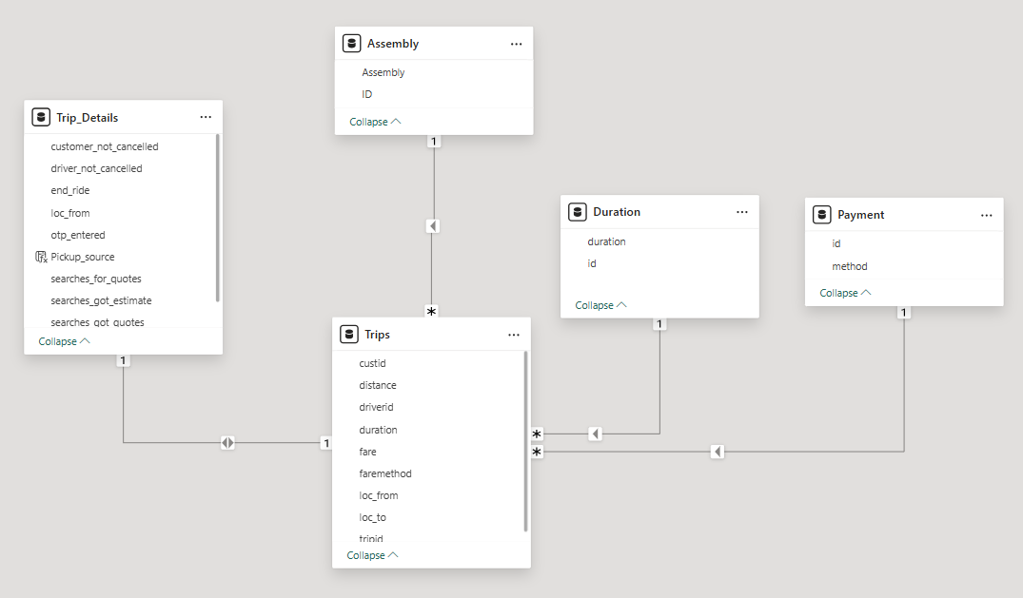
Data Preparation
Import Data and Join Tables
Identify and resolve any inconsistencies or issues in the dataset that might affect the analysis
Change the data from sum to “don’t’ summarize” in the column tool tab to return the data back into right format.
Clean the data
Remove “search” column as there is 100% response “1”.
Create some calculated fields

Slide 8
Exploratory Data Analysis

Slide 9
Objective 1: Identify peak demand patterns and trends.

Slide 10
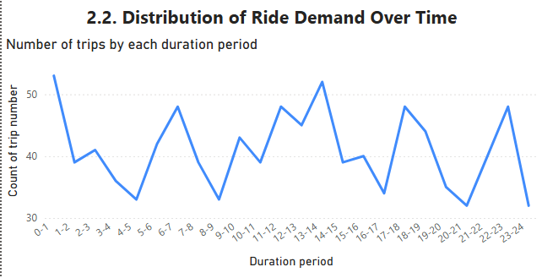
Ride Demand Over Time
Ride demand fluctuates over time throughout the day. The ride demand picks up significantly during 0-1, 6-7, 13-14, 17-18, 22-23. Low periods are 4-5, 8-9, 16-17, 20-21.

Slide 11
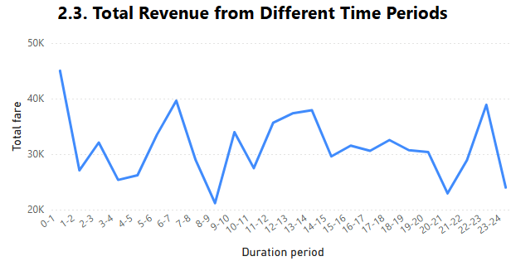
Total Revenue from Different Time Periods
In line with ride demand, similar pattern is observed for total revenue. The revenue reaches highest during periods 0-1, 6-7, 13-14, 17-18, 22-23, and gets the trough in periods 3-5, 8-9, 20-21.

Slide 12
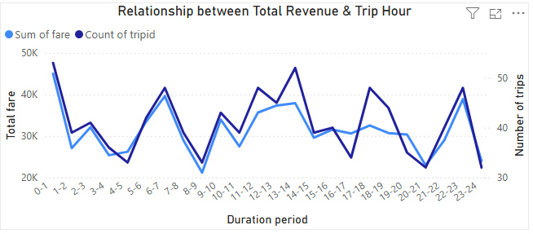
Relationship Between Trip Hour and Revenue
There is a strong relationship between trip hour and revenue. However, there are some certain trip hours when the revenue is not as high as expected due unreasonable fare charged: 11-14, 17-19 periods.

Slide 13
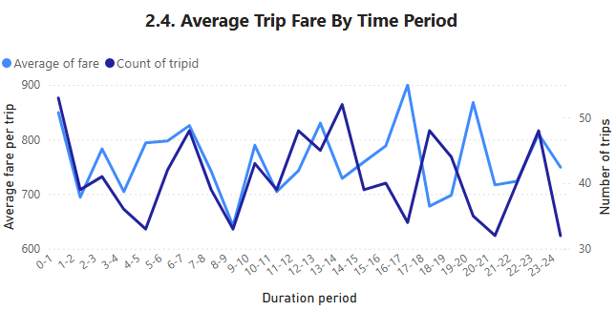
Ride demand vs average fare per trip
For those periods, though ride demand is quite high however trip fare was charged quite low, leading to lower revenue than expected.

Slide 14
Objective 2: Uncover factors influencing cancellations and driver performance

Slide 15
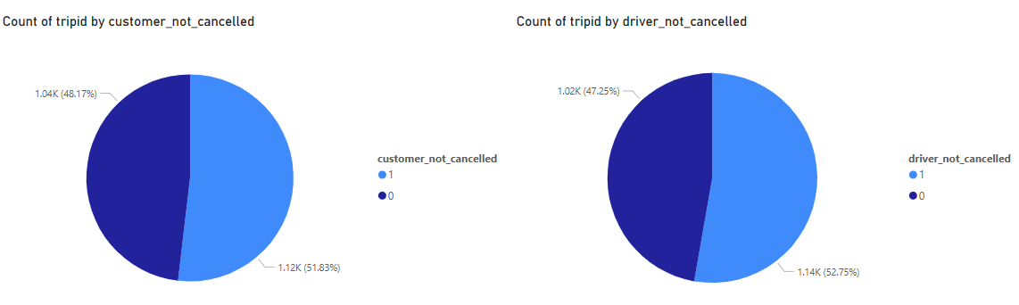
Percentage of cancellation between customers and drivers
The ratio of cancellation derived from customers and drivers are quite similar.

Slide 16
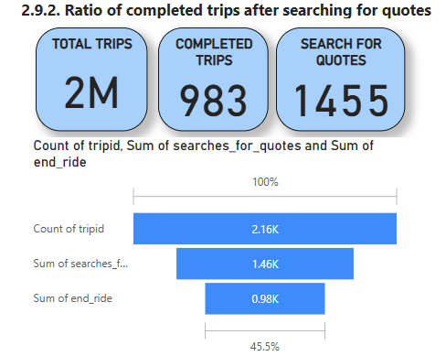
Percentage of people completed trips after searching for quotes
Around two-third of customers completing trips after searching for quotes. There is no significant change among duration period.
67%
68%

Slide 17
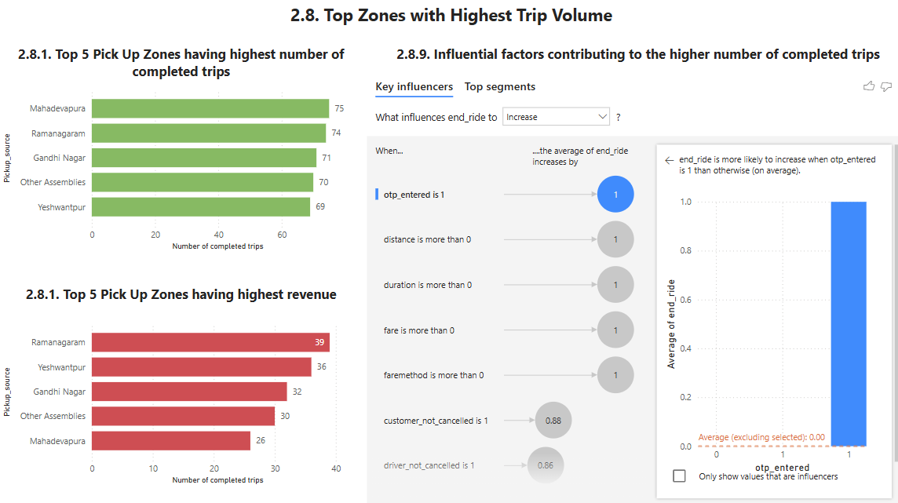
Influential factors contributing to higher number of completed trips
OTP_entered is the most influential factor to signify a successful deal leading to completing trips.

Slide 18
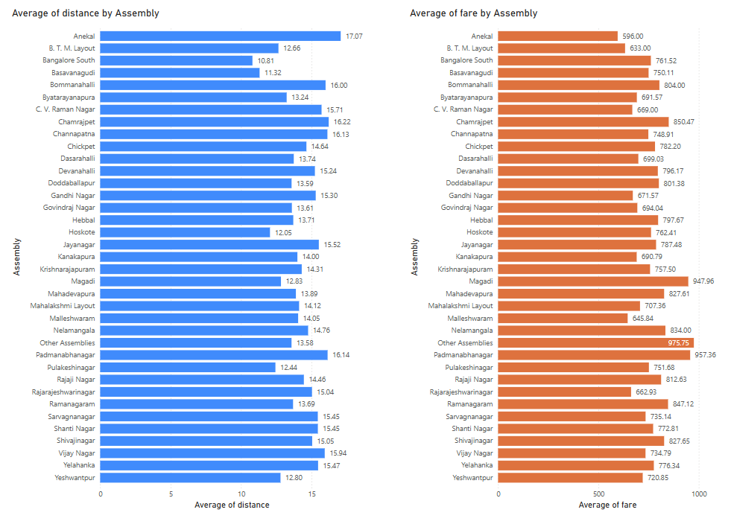
Distance vs Fare by Location
There is no consistent fare charging across location when benchmarking with average distance. I.e. average of distance of Anekal and Bommanahalli are similar but fare charged in Bommanahalli is much higher than Anekal. This can create disappointment for drivers between different locations.

Slide 19
Objective 3: Optimize payment methods and trip durations.

Slide 20
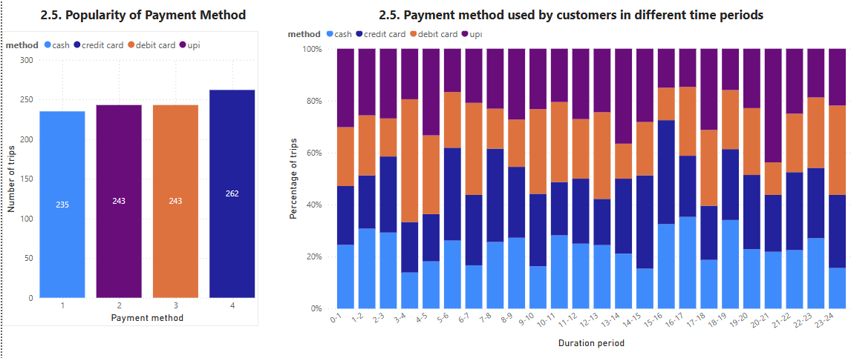
Popularity of Different Payment Methods
Credit card is the most popular payment method, followed by debit card and upi. Different time periods have different preferred payment methods.

Slide 21
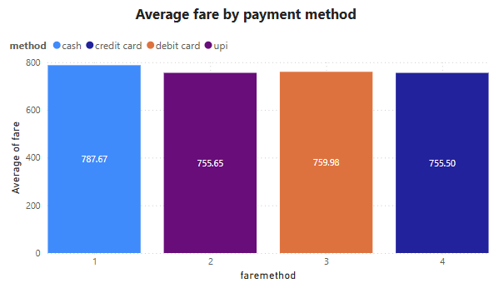
Average fare by payment method
The dominance of credit card may be due to its lowest fare compared to other payment methods. Debit card and upi also have a bit higher fare charge than credit card, but still significantly lower than paying via cash.

Slide 22
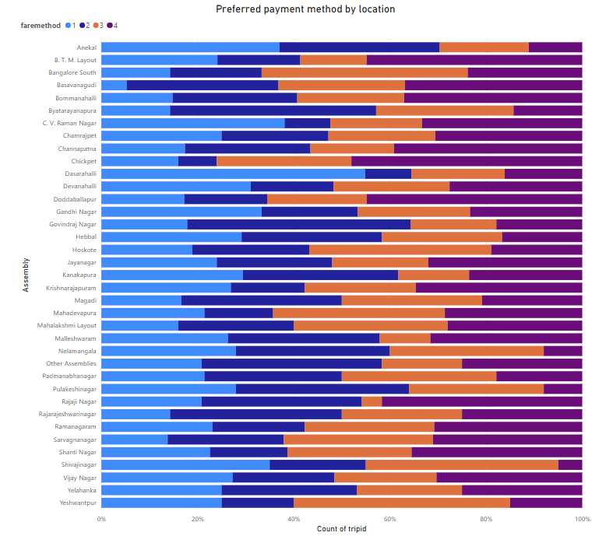
Preferred payment method by location
Different locations have different preferred payment method. Depending on customers’ preference of each location, we provide relevant offers to trigger customers book our ride service.

Slide 23
Objective 4: Improve resource allocation and marketing strategies.

Slide 24
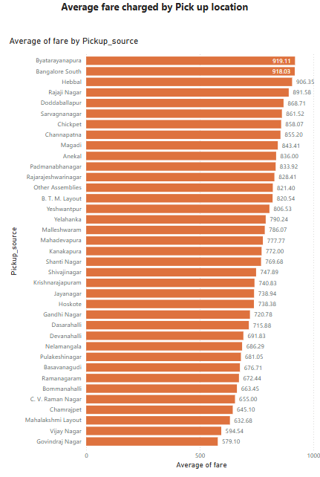
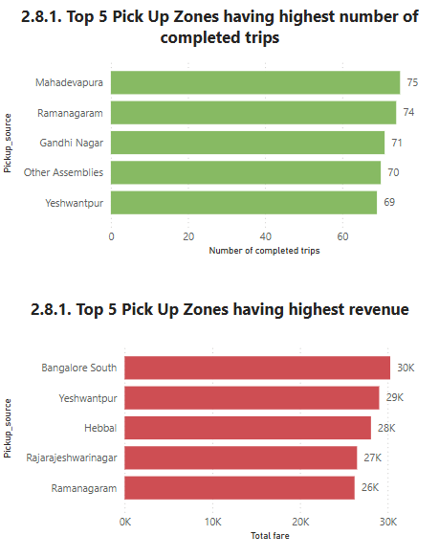
High-Performing Zones
Mahadevapura, Ramanagaram, Gandhi Nagar, Yeshwantpur are top zones in terms of completed trip number (thanks to lower fare) while Bangalore, Yeshwantpur, Hebbai, Rajarajeshwarinagar and Ramanagaram achieve higher revenue.

Slide 25
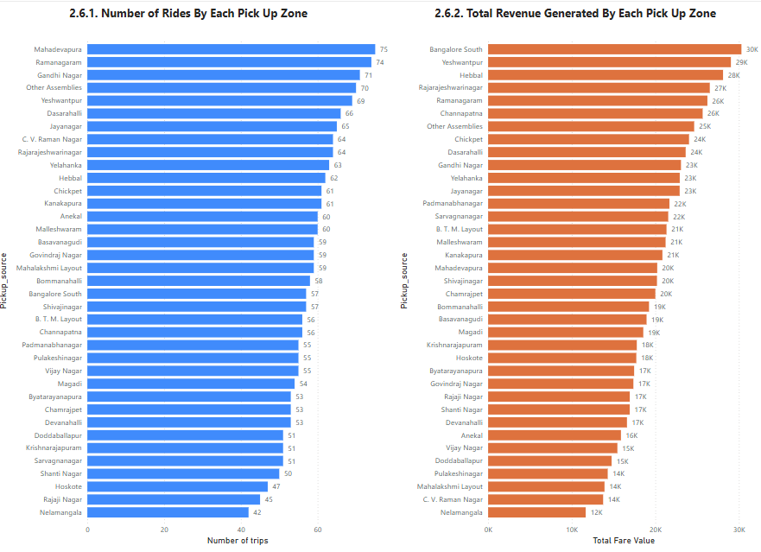
Low performing zones in total revenue

Slide 26
Low-Performing Zones Analysis
Bottom 6 low performing zones in terms of revenue are:
Vijay Nagar, Pulakeshinagar, Mahalashmi Layout & Nelamangaia: due to low number of trips though having quite low fare. → This might be due to low brand awareness of Namma Yattri in these regions.
Doddaballapur: due to low number of trips and really high fare charge. → This might be due to both lower brand awareness as well as high price
C. V. Raman Nagar: having high demand of trips but very low price. → Need to reconsider the pricing strategy for this region to improve the revenue against fair share.

Slide 27
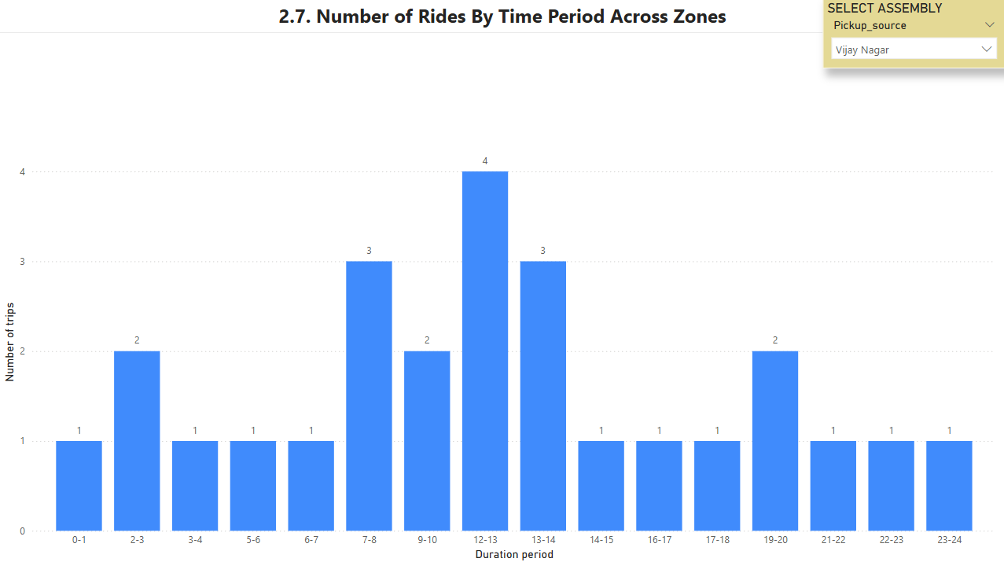
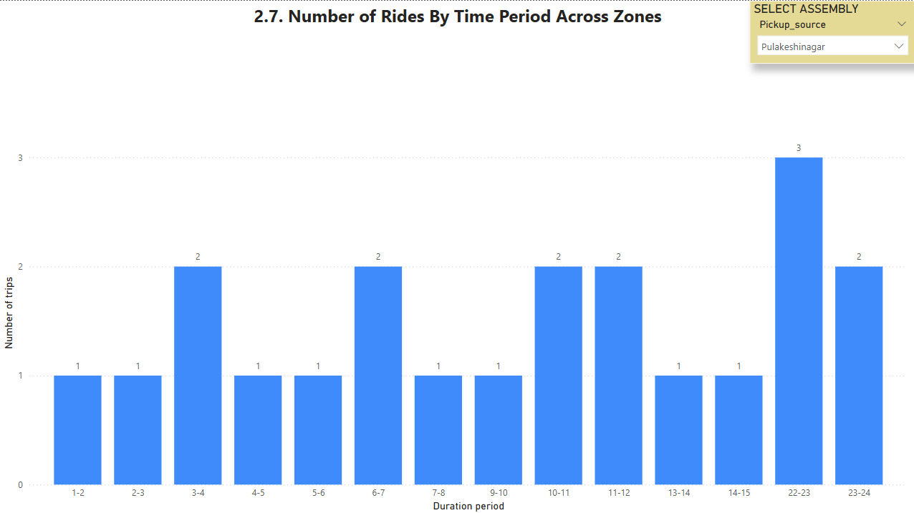
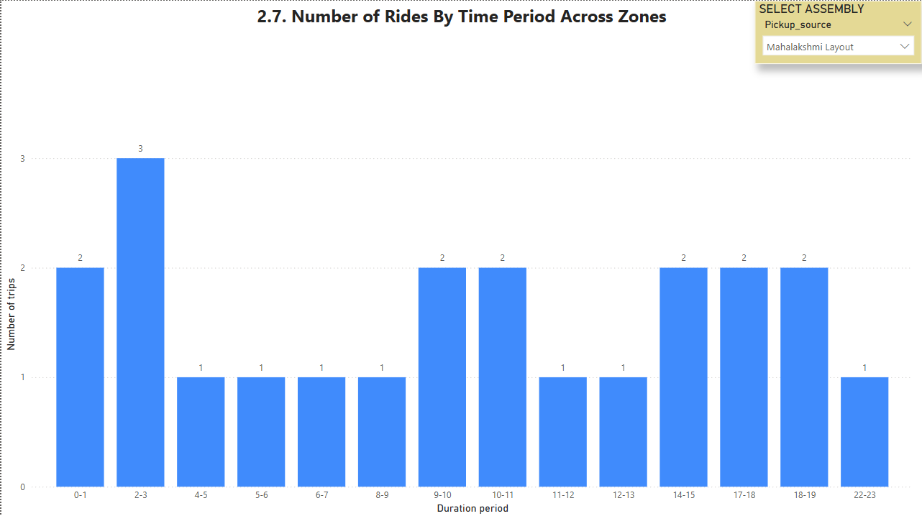
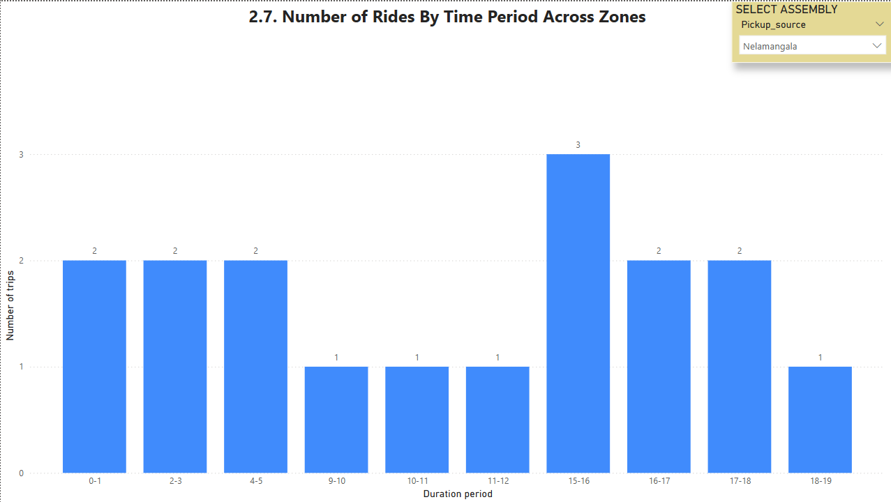
Ride Time Periods Across Zones (1)

Slide 28
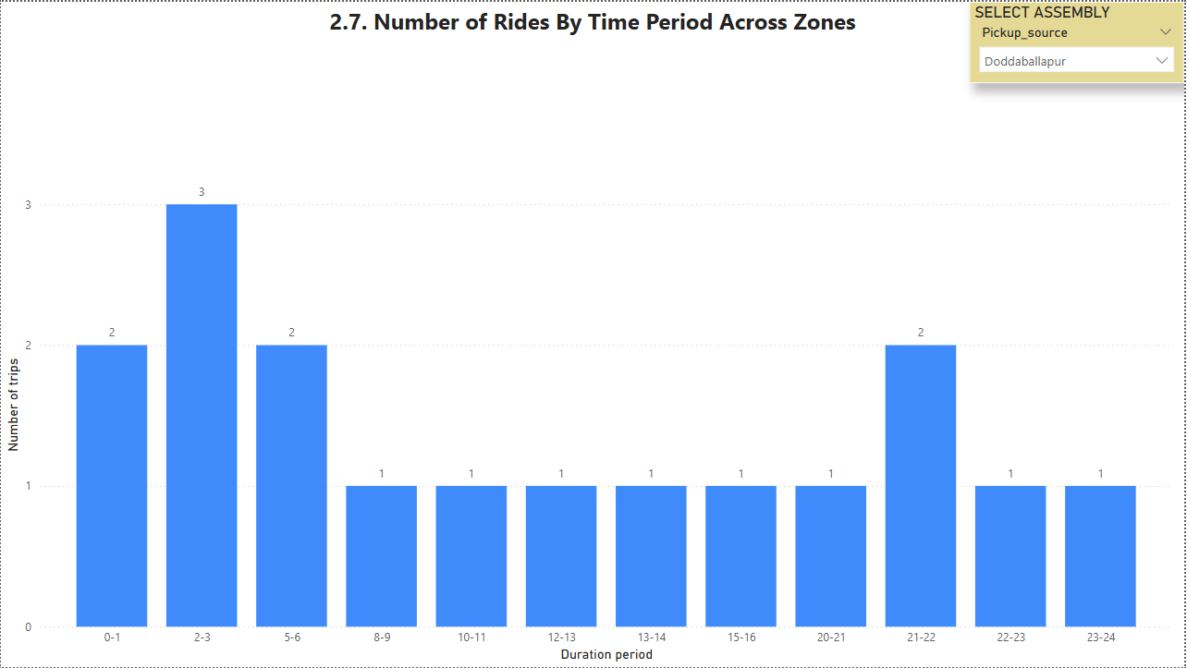
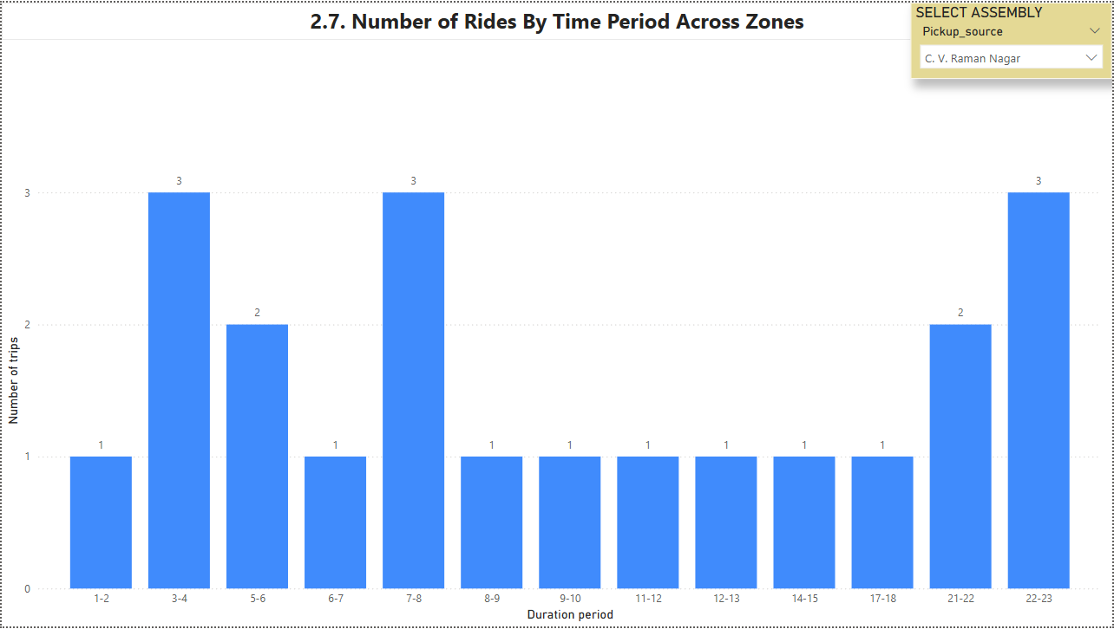
Ride Time Periods Across Zones (2)
Different pick up zones have different peak up time periods. Depending on zones, a customized plan is need to meet customers expectations of those pick up zones.

Slide 29
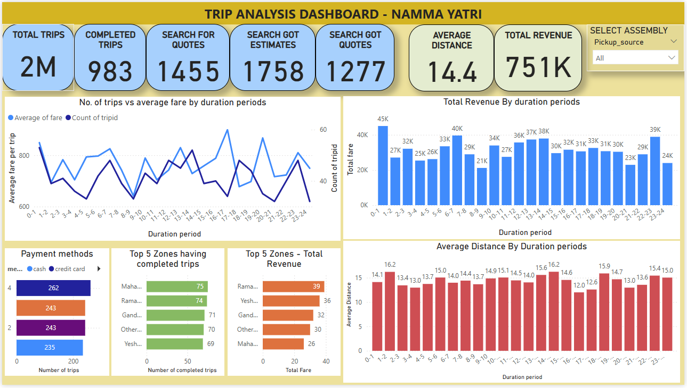
Dashboard

Slide 30
Conclusions & Recommendations

Slide 31
Recommendations for Operational Efficiency
There are certain periods of the day that ride demand increase significantly, thus, the company should boost more drivers to meet that hide demand.
The peak demand of different locations are quite different, there is a need to optimize the resource efficiently to either capture the high demand in peak time and allocate drivers across locations reasonably.
Review pricing strategy across locations to ensure a fare charge for drivers or incentivize drivers in lower charge locations to encourage drivers not to cancel the trip.
Pricing strategy is also need to adjusted to ensure a competitiveness and fairness across locations to trigger the service usage of low demand locations where we observes significantly higher fare charged i.e. Doddaballapur.

Slide 32
Marketing and Operational Strategy Improvements
Launch more marketing campaign in the low demand locations (where having lower number of trips i.e. Vijay Nagar, Pulakeshinagar, Mahalashmi Layout & Nelamangaia, Doddaballapur) to enhance the brand awareness about Namma Yatri company in customers’ mind in those location.
Offer good price to trigger first customers trying service of the company.
Given credit card is the most popular payment method, Namma Yatri can offer some promotion campaigns to offer better price for customers to trigger demand in low period of the day.
Different locations have different preferred payment method. Depending on customers’ preference of each location, we provide relevant offers to trigger customers book our ride service.

Slide 33
Thank you
Truong Tuyet Lam
lam.truongtuyet@gmail.com

